Slide 1
Lab 3 Analysis of Periodic Signals in Frequency Domain

Slide 2
Objective
Explore the relationship between the time domain and the frequency domain.
Understand the Fourier series of periodic signals.
Master the expression of the signal spectrum.

Slide 3
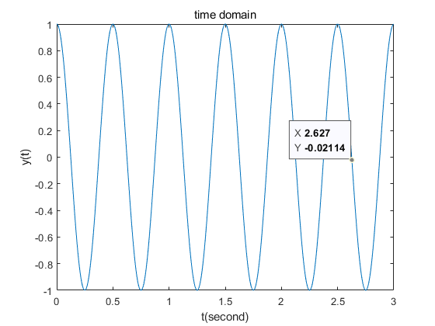
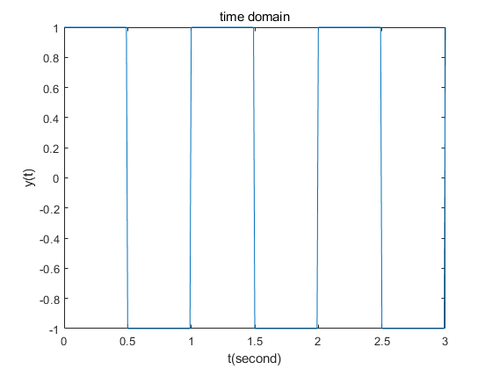
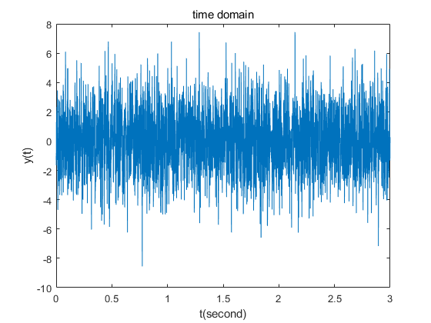
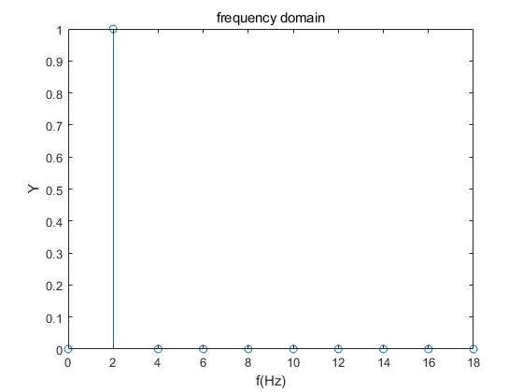
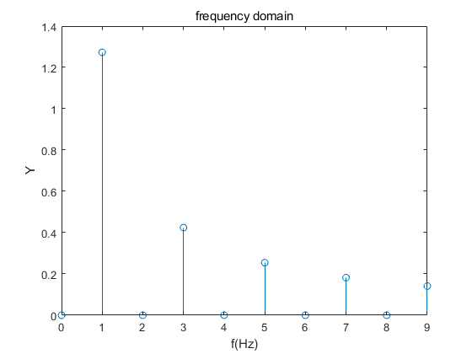
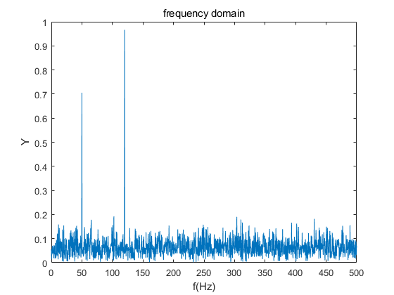
Time Domain and Frequency Domain
Acos(2πft+Ф)

Slide 4
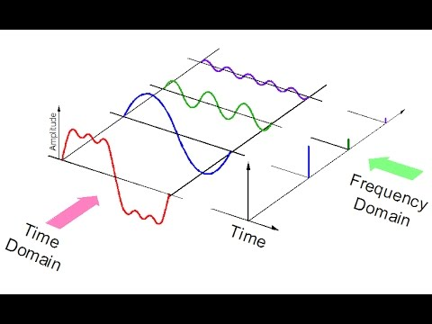
Fourier Series of Periodic Signal

Slide 5
Fourier Analysis
Fourier analysis: Fourier series and Fourier transform
Fourier series: decompose the periodic signal into a trigonometric or exponential format
Fourier transform: represent a no periodic signal by a continuous superposition or integral of complex exponentials.
Dirichlet conditions:
f must be absolutely integrable over a perion.
f must be bounded variation in any given bounded interval.
f must have a finite number of discontinuities in any given bounded interval, and the discontinuities cannot be infinite.

Slide 6
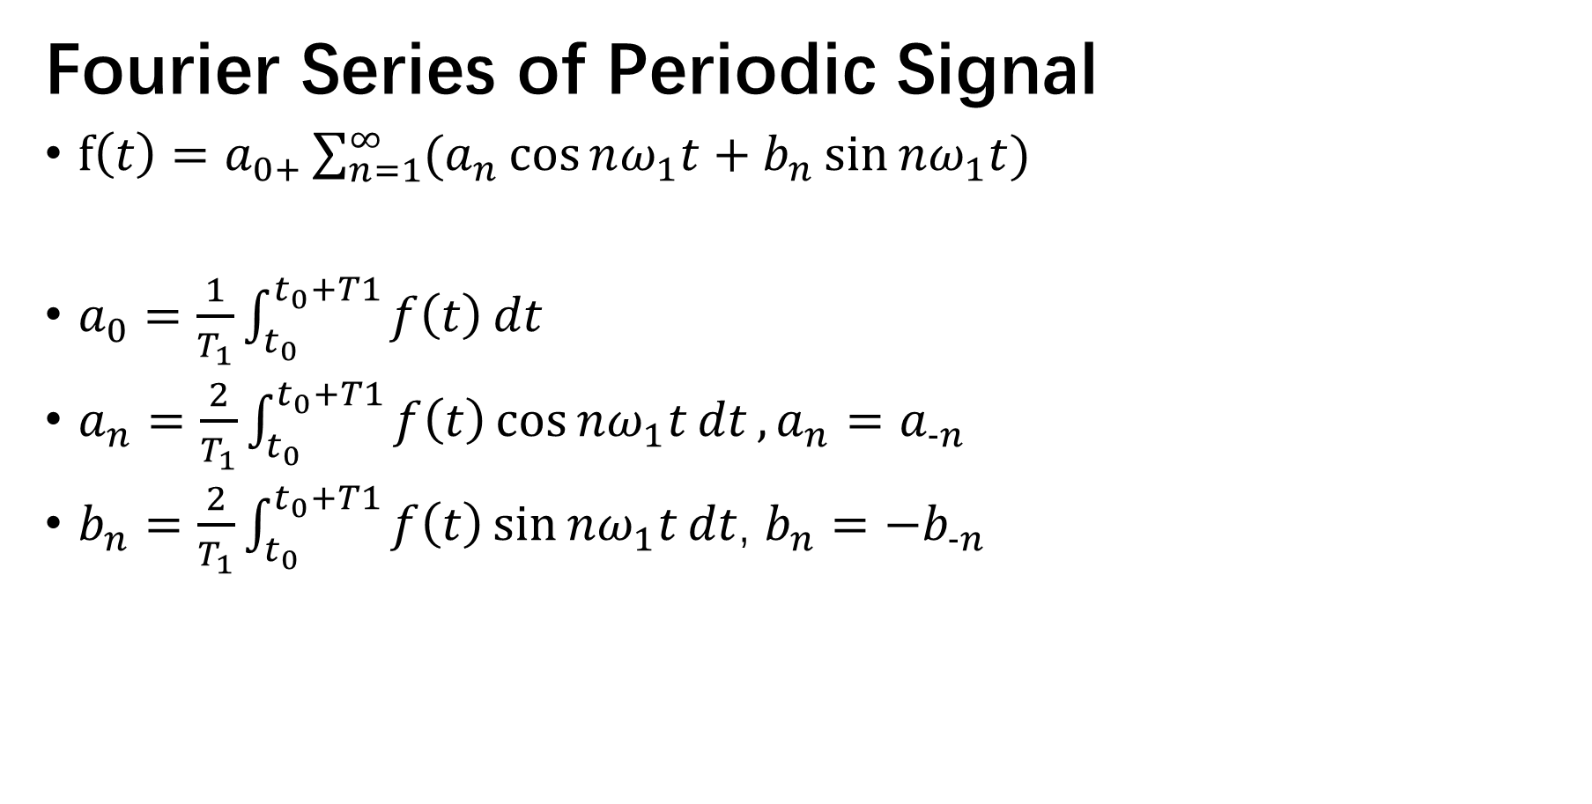
Fourier Series of Periodic Signal
$f\left(t\right)=a_{0+}\sum_{n=1}^{∞}{(a_{n}\cos{nω_{1}t+b_{n}\sin{nω_{1}t}})}$
$a_{0}=\frac{1}{T_{1}}\int_{t_{0}}^{t_{0}+T1}{f\left(t\right)dt}$
$a_{n}=\frac{2}{T_{1}}\int_{t_{0}}^{t_{0}+T1}{f\left(t\right)\cos{nω_{1}t}dt},a_{n}=a_{−n}$
$b_{n}=\frac{2}{T_{1}}\int_{t_{0}}^{t_{0}+T1}{f\left(t\right)\sin{nω_{1}t}dt}$, $b_{n}=−b_{−n}$

Slide 7
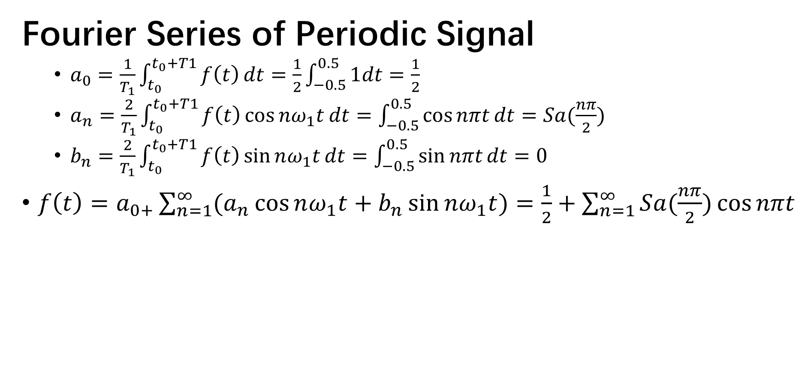
e.g.
Fourier Series of Periodic Signal
$a_{0}=\frac{1}{T_{1}}\int_{t_{0}}^{t_{0}+T1}{f\left(t\right)dt}=\frac{1}{2}\int_{−0.5}^{0.5}{1dt}=\frac{1}{2}$
$a_{n}=\frac{2}{T_{1}}\int_{t_{0}}^{t_{0}+T1}{f\left(t\right)\cos{nω_{1}t}dt}=\int_{−0.5}^{0.5}{\cos{nπt}}dt=Sa(\frac{nπ}{2})$
$b_{n}=\frac{2}{T_{1}}\int_{t_{0}}^{t_{0}+T1}{f\left(t\right)\sin{nω_{1}t}dt}=\int_{−0.5}^{0.5}{\sin{nπt}}dt=0$
$f\left(t\right)=a_{0+}\sum_{n=1}^{∞}{(a_{n}\cos{nω_{1}t+b_{n}\sin{nω_{1}t}})}=\frac{1}{2}+\sum_{n=1}^{∞}{Sa(\frac{nπ}{2})\cos{nπt}}$
T=2, w=2π/T=π

Slide 8
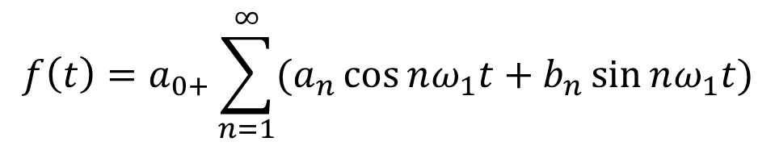
Fourier Series of Periodic Signal
$$f\left(t\right)=a_{0+}\sum_{n=1}^{∞}{(a_{n}\cos{nω_{1}t+b_{n}\sin{nω_{1}t}})}$$

Slide 9
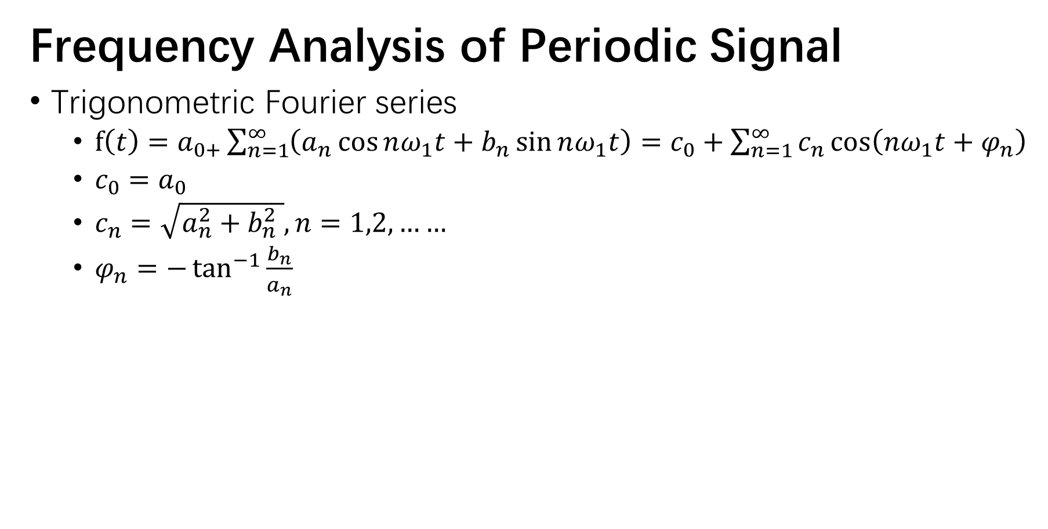
Frequency Analysis of Periodic Signal
Trigonometric Fourier series
$f\left(t\right)=a_{0+}\sum_{n=1}^{∞}{\left(a_{n}\cos{nω_{1}t+b_{n}\sin{nω_{1}t}}\right)}=c_{0}+\sum_{n=1}^{∞}{c_{n}\cos\left(nω_{1}t+φ_{n}\right)}$
$c_{0}=a_{0}$
$c_{n}=\sqrt{a_{n}^{2}+b_{n}^{2} }, n=1,2,……$
$φ_{n}=−\tan^{−1}{\frac{b_{n}}{a_{n}}}$

Slide 10
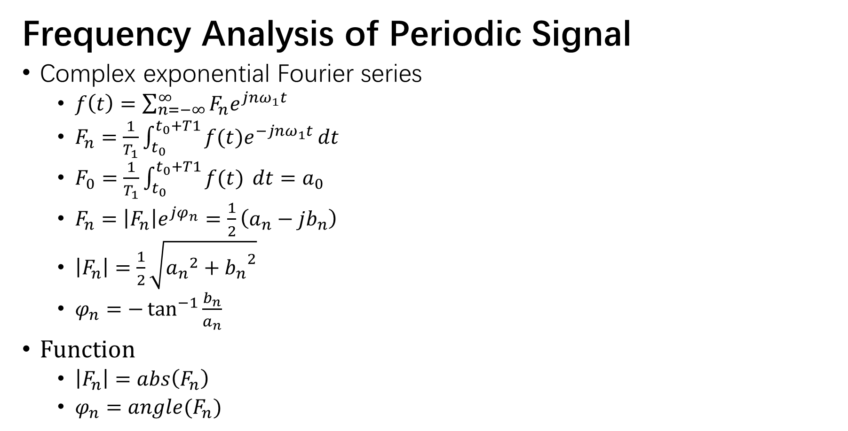
Frequency Analysis of Periodic Signal
Complex exponential Fourier series
$f\left(t\right)=\sum_{n=−∞}^{∞}{F_{n}e^{jnω_{1}t}}$
$F_{n}=\frac{1}{T_{1}}\int_{t_{0}}^{t_{0}+T1}{f(t)e^{−jnω_{1}t}}dt$
$F_{0}={\frac{1}{T_{1}}\int_{t_{0}}^{t_{0}+T1}{f(t) }dt=a}_{0}$
$F_{n}=\left|F_{n}\right|e^{jφ_{n}}=\frac{1}{2}\left(a_{n}−jb_{n}\right)$
$\left|F_{n}\right|=\frac{1}{2}\sqrt{{a_{n}}^{2}+{b_{n}}^{2}}$
$φ_{n}=−\tan^{−1}{\frac{b_{n}}{a_{n}}}$
Function
$\left|F_{n}\right|=abs\left(F_{n}\right)$
$φ_{n}=angle(F_{n})$

Slide 11

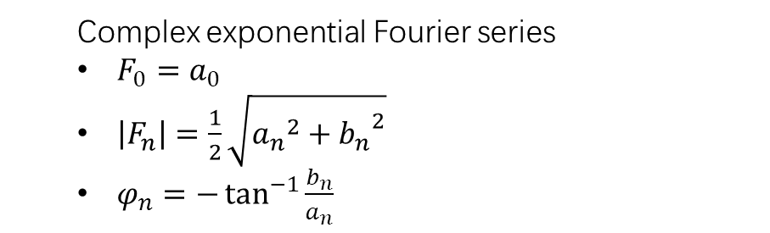

Relationship
Relationship between complex exponential and trigonometric series
$F_{0}=a_{0}=c_{0}$
$F_{n}=\left|F_{n}\right|e^{jφ_{n}}=\frac{1}{2}\left(a_{n}−jb_{n}\right)=\frac{1}{2}c_{n}e^{jφ_{n}}$
$\left|F_{n}\right|=\frac{1}{2}\sqrt{{a_{n}}^{2}+{b_{n}}^{2}}=\frac{1}{2}c_{n}$
$φ_{n}=−\tan^{−1}{\frac{b_{n}}{a_{n}}}$
Trigonometric Fourier series
$c_{0}=a_{0}$
$c_{n}=\sqrt{a_{n}^{2}+b_{n}^{2} }, n=1,2,……$
$φ_{n}=−\tan^{−1}{\frac{b_{n}}{a_{n}}}$
Complex exponential Fourier series
$F_{0}=a_{0}$
$\left|F_{n}\right|=\frac{1}{2}\sqrt{{a_{n}}^{2}+{b_{n}}^{2}}$
$φ_{n}=−\tan^{−1}{\frac{b_{n}}{a_{n}}}$

Slide 12
e.g.
Gibbs Phenomenon

Slide 13
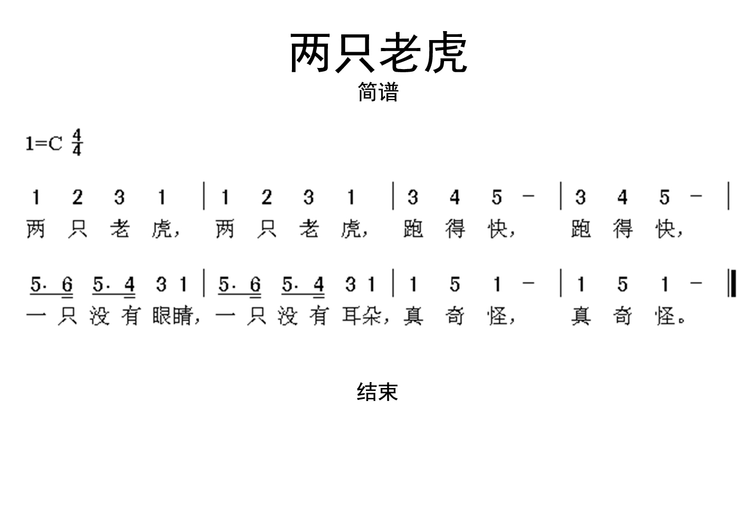
e.g.
中音
1（do）频率: 523 Hz 2（re） 频率: 587 Hz 3（mi）频率: 659 Hz 4（fa） 频率: 698 Hz 5（so）频率: 784 Hz 6（la） 频率: 880 Hz 7（si） 频率: 988 Hz
低音
5 （so）频率: 392Hz

